Slide 1
AliasCluster: A Lightweight Approach to Interface Disambiguation Brian Eriksson Technicolor Palo Alto
Larissa Spinelli
Mark Crovella
Boston University

Slide 2
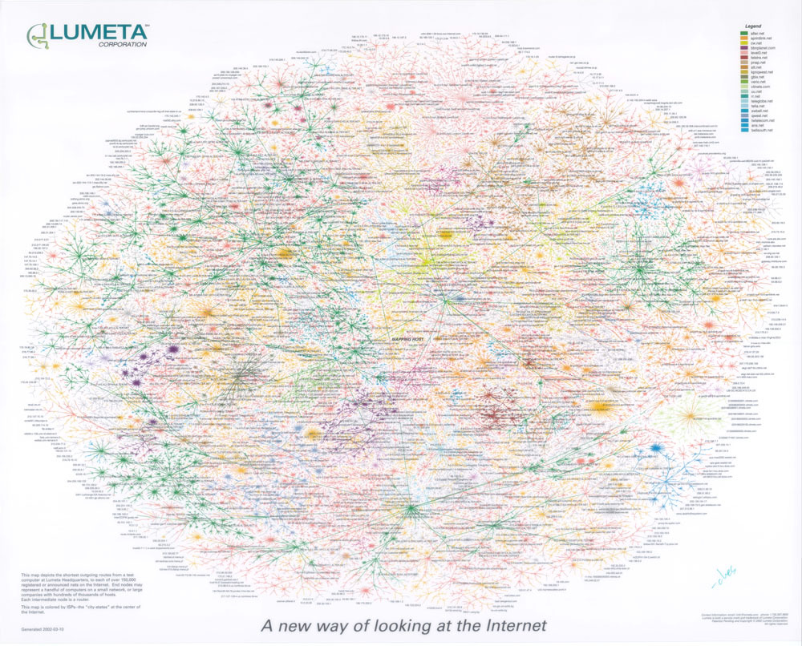
Map of the Internet?
Maps are limited by the measurement tool used : Traceroute.
Traceroute Limitations:
Limited probing coverage
Network Load
Anonymous Routers
Main Focus: Interface IPs ≠ Physical Routers
www.lumeta.com

Slide 3
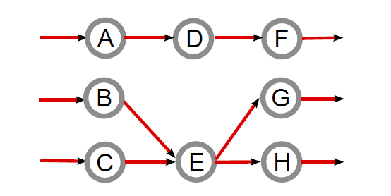
Consider three Traceroute paths:
Inferred topology from Traceroute:
A → D → F
B → E → G
C → E → H
Possible True Physical Topology:
Router #1
Router #2
Router #3
Goal: Interface Disambiguation – Determining aliases : which interface IPs belong to the same physical router.
Prior work (Marchetta et. al. 2011) has shown 10x more interfaces than physical routers

Slide 4
Prior Disambiguation Work and Limitations
Rocketfuel (Ally) – Spring et. al. 2002
Mercator (Iffinder) – Govindam et. al. 2000
Prespecified Timestamps – Sherry et. al. 2010
Merlin – Marchetta et. al. 2011
MIDAR – Keys et. al. 2011
Radargun – Bender et. al. 2008
DisCarte – Sherwood et. al. 2008
APAR (Kapar) – Gunes et. al. 2008
Requires Additional Probing
Requires Router Specific Options
Traceroute Only
Can we estimate router aliases from Traceroute measurements only?

Slide 5
In this paper, we introduce AliasCluster
A → D → F
B → E → G
C → E → H
Given Traceroute Paths:
Given interface IP pairs, how likely is it that they belong to the same physical router?
1
A and E aliased?
B and H aliased?
A and C aliased?
Router 1
Router 2
A
A and E aliased?
B
Given pairwise likelihoods, can we infer router clusters?
C
D
2
B and C aliased?
E
C and D aliased?
D and E aliased?
F
D and H aliased?
G
F and G aliased?
H
G and H aliased?
Router 3

Slide 6
1
Given interface IP pairs, how likely is it that they belong to the same physical router?
Consider two observed IP interfaces, i and j.
Goal:
Set of relevant features of i and j from Traceroute.
For example, IP Subnet
Likely that 173.194.40.84 and 173.194.40.86 (e.g., /30) are aliases
Less likely that 173.194.40.84 and 173.92.9.185 (e.g., /8) are aliases

Slide 7
Key observation - Down-path observations contain relevant alias information
Percentage Out-degree Match
Out of all the down-path interfaces observed for interface A, what percent are observed for both A and B?
Percent Hop Count Match
For those commonly observed interfaces, what percent observe the same hop count?
Non-Aliases
Aliases
Common out-degree interface
X
A
A
X
Unique out-degree interface
B
B
A → … → X
B → … → X
A→M→N→X
B→P→Q→X
2 hops

Slide 8
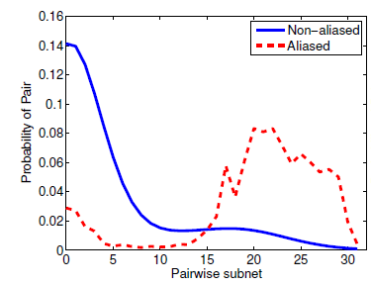
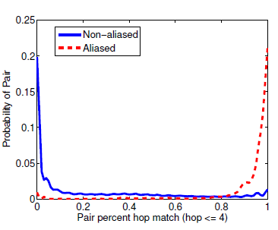
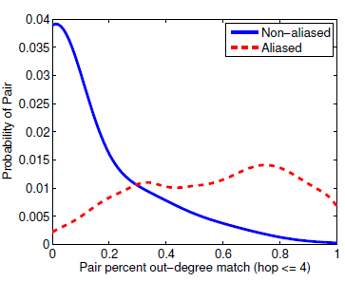
IP Subnet
Hop Match Percent
Out-Degree Match Percent

Slide 9
1
Given interface IP pairs, how likely is it that they belong to the same physical router?
Traceroute extracted features (e.g., IP subnet, hop count match,etc.)
Solution: Naïve Bayes (i.e., assume independence)
Transforms problem from estimating one K-dimension likelihood, to estimating K one-dimensional likelihoods.

Slide 10
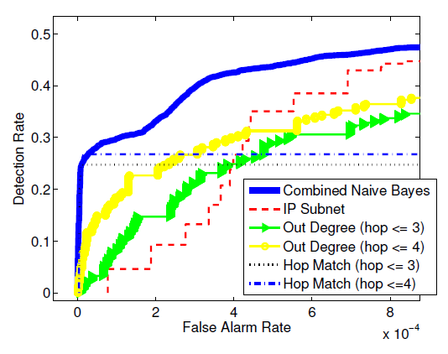
Naïve Bayes – Combined Performance

Slide 11
2
Given pairwise likelihoods, can we infer router clusters?
Consider the following problem with 3 IP interfaces:
i
is high
is high
j
k
is low
i,j?
i,k?
What is the physical router?
i,j,k?
While Naïve Bayes is returns the likelihood that two interfaces are aliased, not the inferred routers clusters.

Slide 12
2
Given pairwise likelihoods, can we infer router clusters?
We perform a modified hierarchical clustering approach.
j
i
Alias Likelihood Matrix

Slide 13
2
Given pairwise likelihoods, can we infer router clusters?
We perform a modified hierarchical clustering approach.
N Interfaces
Alias Likelihood Matrix
N Interfaces

Slide 14
2
Given pairwise likelihoods, can we infer router clusters?
We perform a modified hierarchical clustering approach.
n
Largest Likelihood, s₁
m
s₁
m
n
Alias Likelihood Matrix

Slide 15
2
Given pairwise likelihoods, can we infer router clusters?
We perform a modified hierarchical clustering approach.
x
2nd Largest Likelihood, s₂
y
s₁
s₂
0
m
n
x
y
Alias Likelihood Matrix

Slide 16
2
Given pairwise likelihoods, can we infer router clusters?
We perform a modified hierarchical clustering approach.
s₇
s₆
s₅
s₁
s₂
s₃
s₄
Alias Likelihood Matrix
Repeated until the tree is found

Slide 17
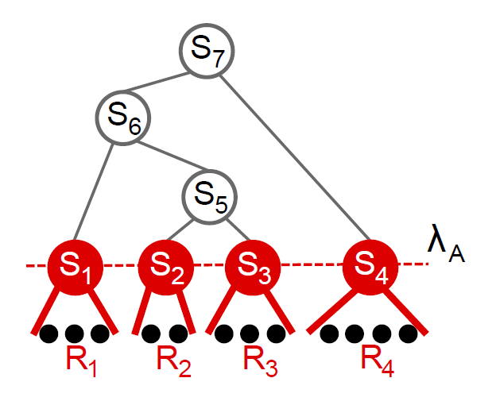
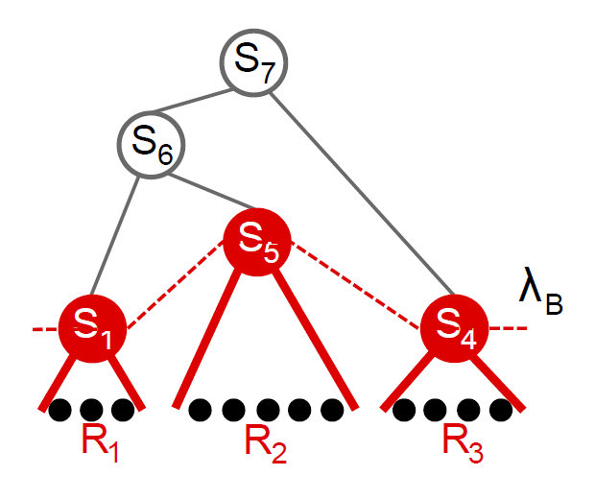
Using the internal node values, we threshold to resolve physical routers.
Consider S₁ > S₂ > S₃ > S₄ > S₅ > S₆ > S₇
S₄ > λ_{A} > S₅
S₅ > λ_{B} > S₆
The detection/false alarm rate as this threshold is adjusted defines the performance of AliasCluster.

Slide 18
Experiment Setup
Traceroute data is from the CAIDA Macroscopic Internet Topology Data Kit from July 2010
54 source monitors to all /24 prefixes
Over 2.1 million unique router interface addresses
Ground truth router aliases found using the MERLIN project (Marchetta et. al. 2011).
Allow us to consider subset of routers with true positives and true negatives.
This reduces the topology under consideration to 63,479 router interfaces in 19,027 physical routers.

Slide 19
For KAPAR’s 26% detection rate on the ARK measurements:
Methodology | Number of False Alarms | Percentage of False Alarms (x10⁻⁵)
KAPAR (Keys 2012) | 16,644 | 3.305
AliasCluster | 8,388 | 1.666
False alarm rates for varying detection rates:
Methodology | 20% Detection Rate | 30% Detection Rate | 40% Detection Rate
AliasCluster | 7.92 x 10⁻⁶ | 1.26 x 10⁻⁴ | 7.58 x 10⁻⁴

Slide 20
Conclusions
AliasCluster – A lightweight technique for interface disambiguation
Requires no additional probes/measurements
Using statistical learning to determine aliases from Traceroute only
General framework allows for extensions to other features
Experiments on CAIDA Ark measurements results in 50% reduction in the false alarm rate compared with the current state-of-the-art.

Slide 21
Future Work
Larger-scale studies
Aggregated Ark Trace data sets
More alias ground truth information
Additional Traceroute extracted features
Historical longitudinal study
How has the number of routers changed over time?

Slide 22
Questions?

Slide 23
1
Given interface IP pairs, how likely is it that they belong to the same physical router?
Traceroute extracted features (e.g., IP subnet, common down-path interfaces,etc.)
Likelihood term – Difficult to calculate
Prior term – Easy to calculate
Why difficult? – The “curse of dimensionality”
Solution: Naïve Bayes (i.e., assume independence)
Transforms problem from estimating one K-dimension likelihood, to estimating K one-dimensional likelihoods.

