Slide 1
Understanding Geolocation Accuracy using Network Geometry
Brian Eriksson
Technicolor Palo Alto
Mark Crovella
Boston University

Slide 2

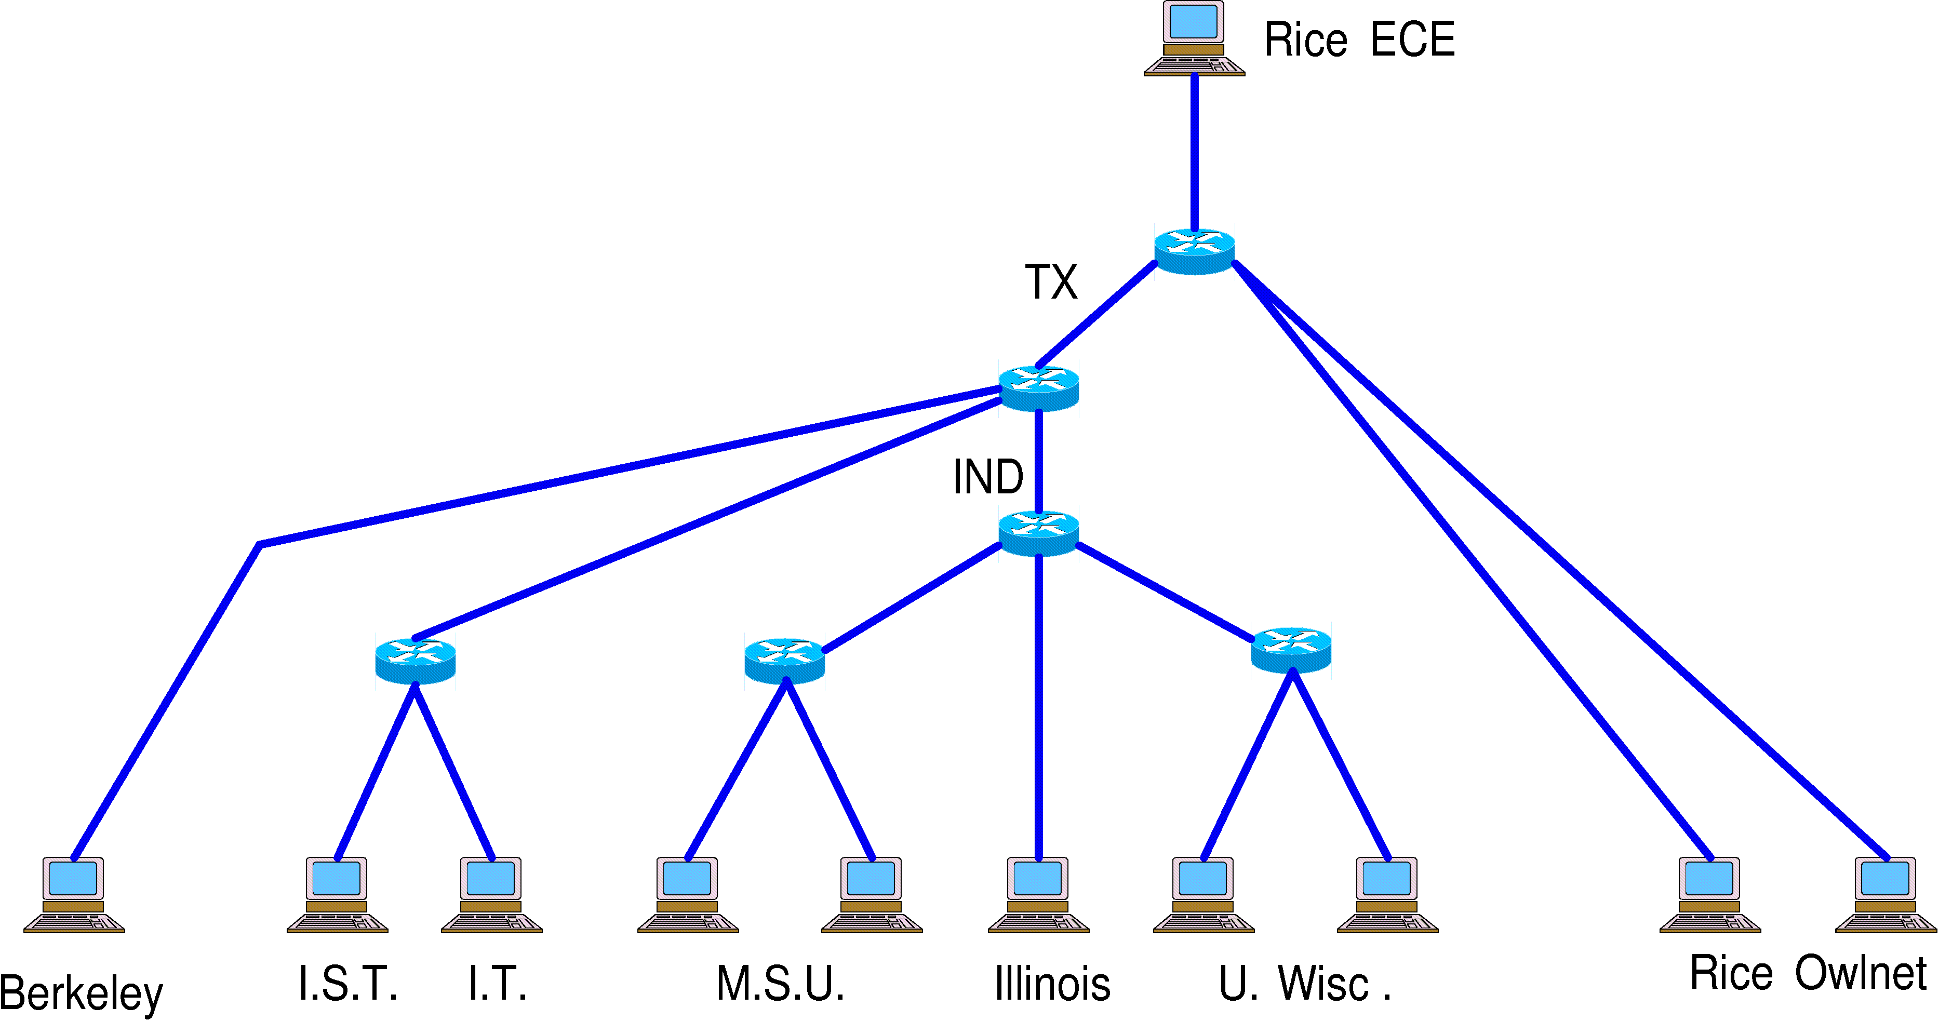
Our focus is on IP Geolocation
Internet
?
?
?
?
?
Target
Geographic location (geolocation)?
Why? : Targeted advertisement, product delivery, law enforcement, counter-terrorism

Slide 3

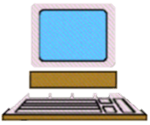
Measurement-Based Geolocation
Landmark
d
Estimated Distance
(known location)
delay
Target
(unknown location)
  Landmark Properties:
1
  Known geographic location
2
  Delay Measurements to Targets
-Estimated distance (Speed of light in fiber)

Slide 4
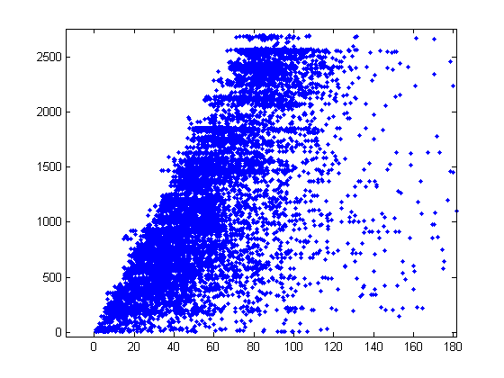
Measured Delay vs. Geographic Distance
Ideal
Geographic Distance (miles)
Measured Delay (in ms)
Over 80,000 pairwise delay measurements with known geographic line-of-sight distance.

Slide 5
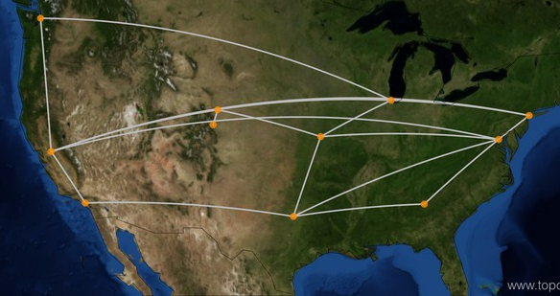
Why does this deviation occur?
Geographic Distance (miles)
Measured Delay (in ms)
Delay-to-Geographic Distance Bias
Line-of-sight
The Network Geometry (the geographic node and link placement of the network) makes geolocation difficult
Landmark
Routing Path
Target
Sprint North America

Slide 6
To defeat the Network Geometry, many measurement-based techniques have been introduced.
Methodology | Published Median Error
Shortest Ping - [Katz -Bassett et. al. 2007] | 69 miles
Topology-Based - [Katz -Bassett et. al. 2007] | 118 miles
 | 41 miles
Constraint-Based – [Gueye et. al. 2006] | 13.6 miles
 | 59 miles
Posit – [Eriksson et. al. 2012] | 21 miles
Street-Level - [Wang et. al. 2011] | 0.42 miles
?
Worst Technique
?
Best Technique
All of these results are on different data sets!

Slide 7
The number of landmarks is inconsistent.
Methodology | Published Median Error | Number of Landmarks
Shortest Ping - [Katz -Bassett et. al. 2007] | 69 miles | 68
Topology-Based - [Katz -Bassett et. al. 2007] | 118 miles | 11
 | 41 miles | 68
Constraint-Based – [Gueye et. al. 2006] | 13.6 miles | 42
 | 59 miles | 95
Posit – [Eriksson et. al. 2012] | 21 miles | 25
Street-Level - [Wang et. al. 2011] | 0.42 miles | 76,000
What if this technique used 76,000 landmarks?
What if this technique used 11 landmarks?

Slide 8
And, the locations are inconsistent.
Methodology | Published Median Error | Number of Landmarks | Locations
Shortest Ping - [Katz -Bassett et. al. 2007] | 69 miles | 68 | North America
Topology-Based - [Katz -Bassett et. al. 2007] | 118 miles | 11 | North America
 | 41 miles | 68 | North America
Constraint-Based – [Gueye et. al. 2006] | 13.6 miles | 42 | Western Europe
 | 59 miles | 95 | Continental US
Posit – [Eriksson et. al. 2012] | 21 miles | 25 | Continental US
Street-Level - [Wang et. al. 2011] | 0.42 miles | 76,000 | United States

Slide 9
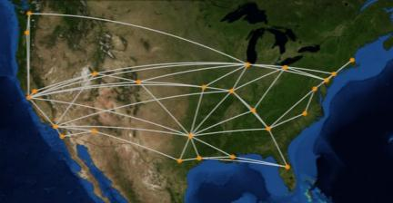
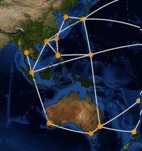
Our focus is on characterizing geolocation performance.
How does accuracy change with the number of landmarks?
1
vs.
3 landmarks
10 landmarks
How does accuracy change with the geographic region of the network?
2
vs.
“Excellent” Geolocation Performance
“Poor” Geolocation Performance

Slide 10
We focus on two methods:
Methodology | Published Median Error | Number of Landmarks | Locations
Shortest Ping - [Katz -Bassett et. al. 2007] | 69 miles | 68 | North America
Topology-Based - [Katz -Bassett et. al. 2007] | 118 miles | 11 | North America
 | 41 miles | 68 | North America
Constraint-Based – [Gueye et. al. 2006] | 13.6 miles | 42 | Western Europe
 | 59 miles | 95 | Continental US
Posit – [Eriksson et. al. 2012] | 21 miles | 25 | Continental US
Street-Level - [Wang et. al. 2011] | 0.42 miles | 76,000 | United States

Slide 11
Constraint-Based
Target
Landmarks

Slide 12
Constraint-Based
Maximum Geographic Distance
Feasible Region

Slide 13
Constraint-Based
Estimated Location
Feasible Region Intersection

Slide 14
Estimated Location
Smallest Delay
Target
Landmarks
Constraint-Based
Shortest Ping
Estimated Location
Feasible Region Intersection

Slide 15
Maximum Geolocation Error
Maximum Geolocation Error
Shortest Ping w/ 5 landmarks
Shortest Ping w/ 4 landmarks
Maximum Geolocation Error
Background: Fractal dimension, Hausdorff dimension, covering dimension, box counting dimension, etc.
Number of Landmarks
α error ^{(-β)}
Shortest Ping w/ 6 landmarks
Where the Network Geometry defines the scaling dimension, β>0

Slide 16
Network Geometry
Estimated scaling dimension, β
Given shortest path distances on network geometry, we use ClusterDimension [Eriksson and Crovella, 2012]
Scaling dimension, β = 1.119
β = 0.739
β = 0.557
Intuition: Measures closeness of routing paths to line of sight.

Slide 17
Scaling Dimension and Accuracy
For M landmarks and scaling dimension β, we find:
M α error ^{(-β)}
error α M^{(-1/β)}
Large reduction in error using more landmarks.
Small reduction in error using more landmarks.
β = 1.119
β = 0.557

Slide 18
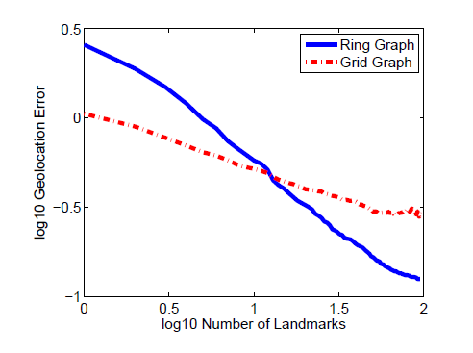
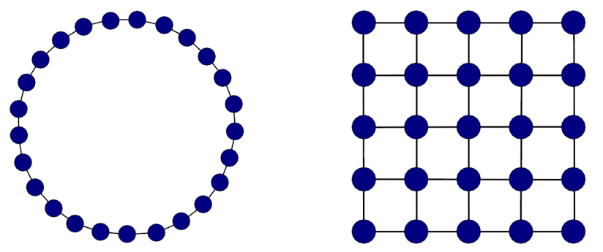
Lower dimension networks perform better with many landmarks
Power Law Decay = -γ_{grid}
Ring Graph
(dim. β ≈ 1)
Grid Graph
(dim. β ≈ 2)
Higher dimension networks perform better with few landmarks
Power Law Decay = -γ_{ring}
(M)
1
The intuition holds, the accuracy decays like O(M^{- 1/β})
2
Both graphs follow a power law decay (γ) with respect to geolocation error rate.

Slide 19
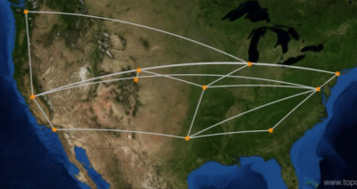
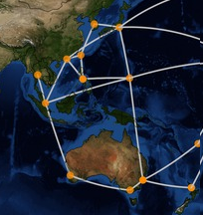
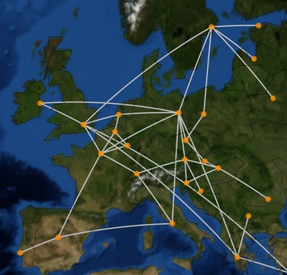
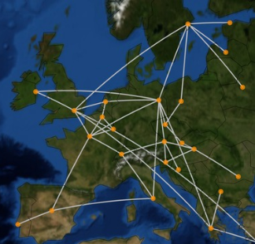
Topology Zoo Experiments
Region | Number of Networks
Europe | 7
North America | 8
South America | 3
Japan | 2
Oceania | 4
From network geometry - Estimated Scaling Dimension, β
1
2
Geolocation error power law decay, γ (assumption, ≈ 1/β)
Internet Topology Zoo Project - http://www.topology-zoo.org/

Slide 20
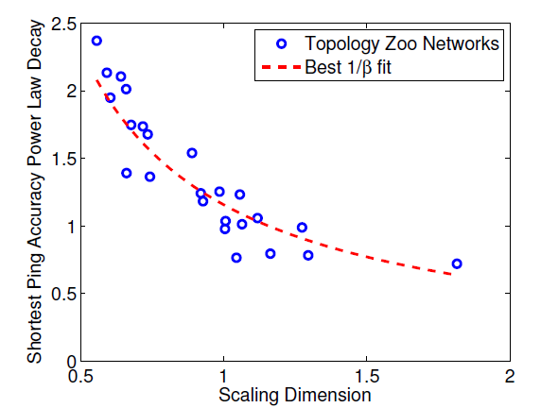
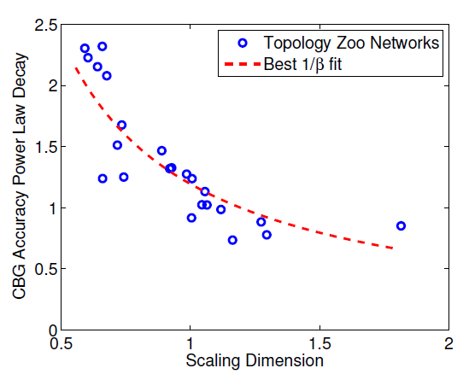
Shortest Ping and Scaling Dimension
Constraint-Based and Scaling Dimension
γ
β
R² = 0.855
R² = 0.787
Goodness-of-fit to 1/β curve

Slide 21
We find consistency across geographic regions.
Geographic Region | Number of Networks | Scaling Dimension
 |  | Mean | Standard Dev.
Japan | 2 | 1.104 | 0.083
Europe | 7 | 1.148 | 0.32
North Amer. | 8 | 0.924 | 0.223
South Amer. | 3 | 0.681 | 0.053
Oceania | 4 | 0.617 | 0.069
“Poor” Geolocation Performance
“Excellent” Geolocation Performance

Slide 22
Conclusions
Geolocation accuracy comparison is difficult due to inconsistent experiments.
Methodology | Published Median Error | Number of Landmarks | Locations
Shortest Ping - [Katz -Bassett et. al. 2007] | 69 miles | 68 | North America
Topology-Based - [Katz -Bassett et. al. 2007] | 118 miles | 11 | North America
 | 41 miles | 68 | North America
Constraint-Based – [Gueye et. al. 2006] | 13.6 miles | 42 | Western Europe
 | 59 miles | 95 | Continental US
Posit – [Eriksson et. al. 2012] | 21 miles | 25 | Continental US
Street-Level - [Wang et. al. 2011] | 0.42 miles | 76,000 | United States

Slide 23
Conclusions
The scaling dimension of a network is proportional to its geolocation accuracy decay.
Ring Graph
(dimension ≈ 1)
Grid Graph
(dimension ≈ 2)

Slide 24
Conclusions
Results on real-world networks fit to this trend and demonstrate consistency across geographic regions.
Geographic Region | Number of Networks | Average Scaling Dimension
Japan | 2 | 1.104
Europe | 7 | 1.148
North America | 8 | 0.924
South America | 3 | 0.681
Oceania | 4 | 0.617
R² = 0.855

Slide 25
Questions?

